Slide 1
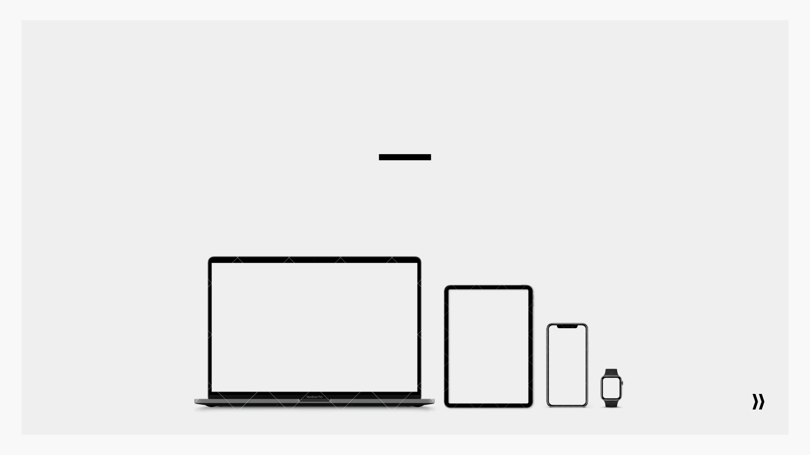
Bringing Science to the Art of Marketing
Team Parliament

Slide 2
Table of Contents
1 Executive Summary
2 Objective & Problem statement
3 Data description
4 Past campaign analysis
5 Customers from latest campaign
6 Model result
7 Customer clusters
8 Insight for future campaigns
9 Conclusion

Slide 3
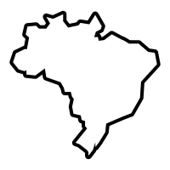
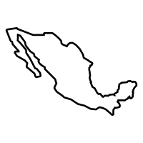
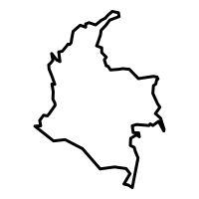
Company Overview
iFood Prominent online food delivery startup in Latin America
Serving Brazil Mexico Colombia
Founded 2011
fulfills millions of orders per month
THOUSANDS
of restaurants registered in database

Slide 4
Executive Summary
Our goal is to provide a solution through a cost-effective and targeted marketing campaign to drive up sales and maximize the profits.

Slide 5
Problem & Objective
Inefficient marketing strategy
Low success rate
Negative Profits
Current State
Data driven targeted marketing campaign
Generate value by maximizing ROI
Quantify marketing campaign performance
Future State

Slide 6
Data Description
Contains socio/demographic features of nearly 2,240 customers
Category of Products
Wine
Meat
Fruits
Sweet Products
Fish
Gold
Marketing Channels
Catalog
Online
Physical Stores
Information on past marketing campaigns, whether successful or not.

Slide 7
Initial Story from The Data
1. High-Income People — tend to spend more and purchase more — tend to visit the company’s website less frequently than others — tend to have few number of purchases made with a discount
2. People with kids at home — tend to spend less and purchase less — tend to have a high number of purchases made with a discount
3. People who purchased with a high average order volume — tend to buy more wines and meat products — tend to make a high number of purchases using a catalog — tend not to visit the company’s website

Slide 8
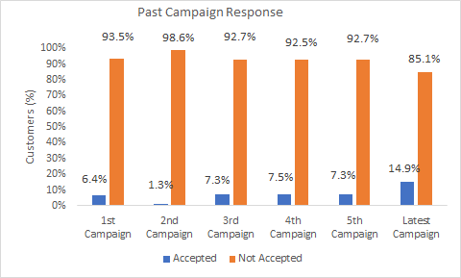
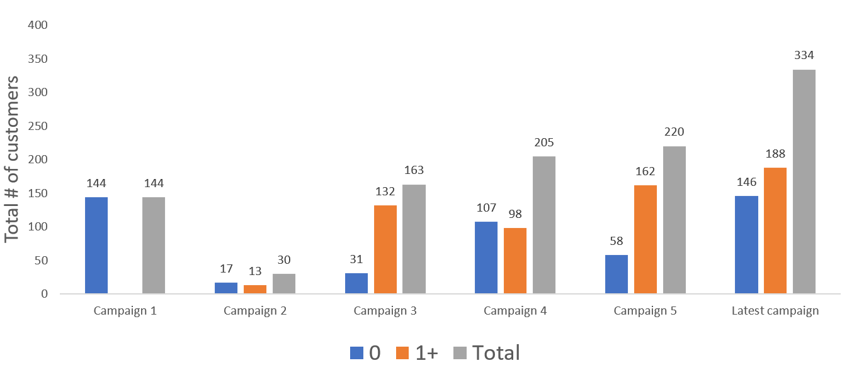
Past Campaign Analysis
If customers accepted any previous campaigns
The last marketing campaign, was the most successful one
Performed nearly twice as well as the previous campaigns, except campaign 2
144 customers accepted the offer in the 1st campaign
High conversion rate on the latest campaign

Slide 9
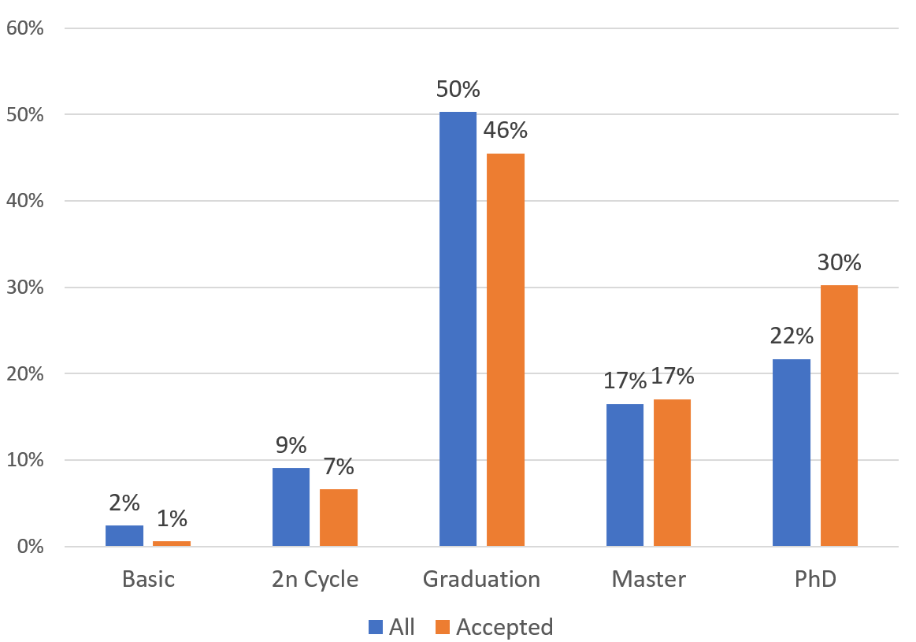
Latest Campaign - Education Segment
334 customers accepted
Two customers from Basic education accepted the campaign
PhD portion increased from 22% of whole customer profile
Notes:
Only 2 people from Basic
More PhD accepted the latest campaign

Slide 10
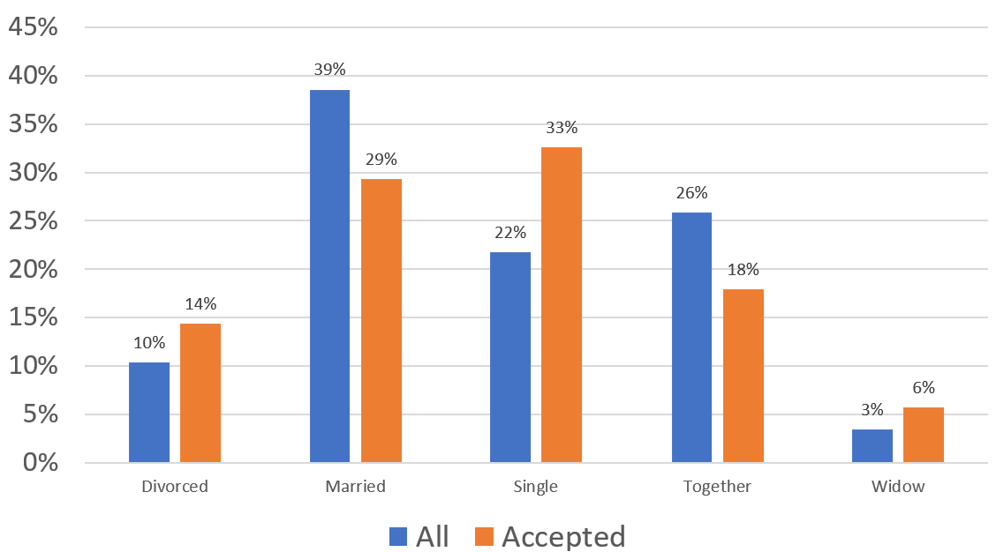
Marital Status Segment
More single customers accepted our latest campaign

Slide 11
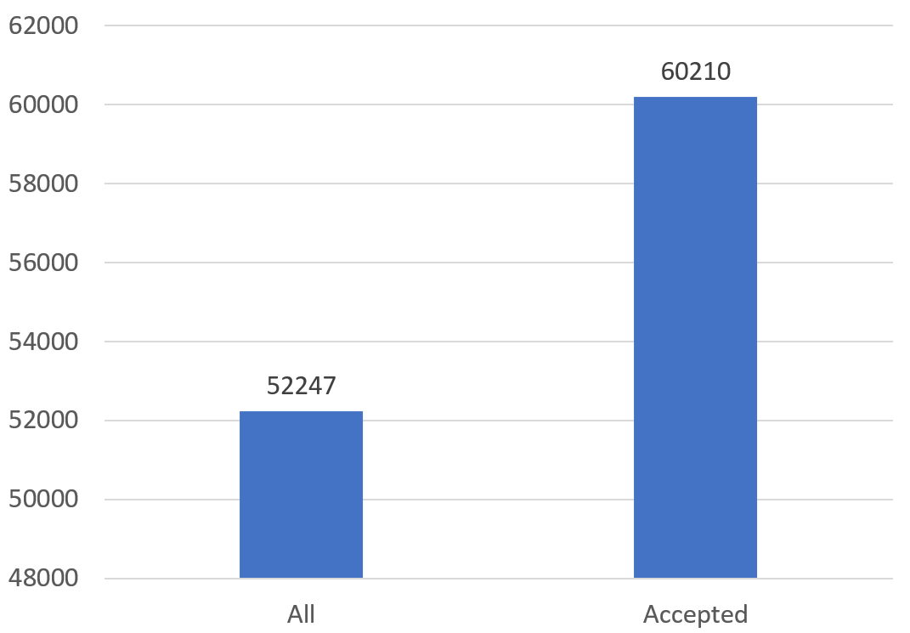
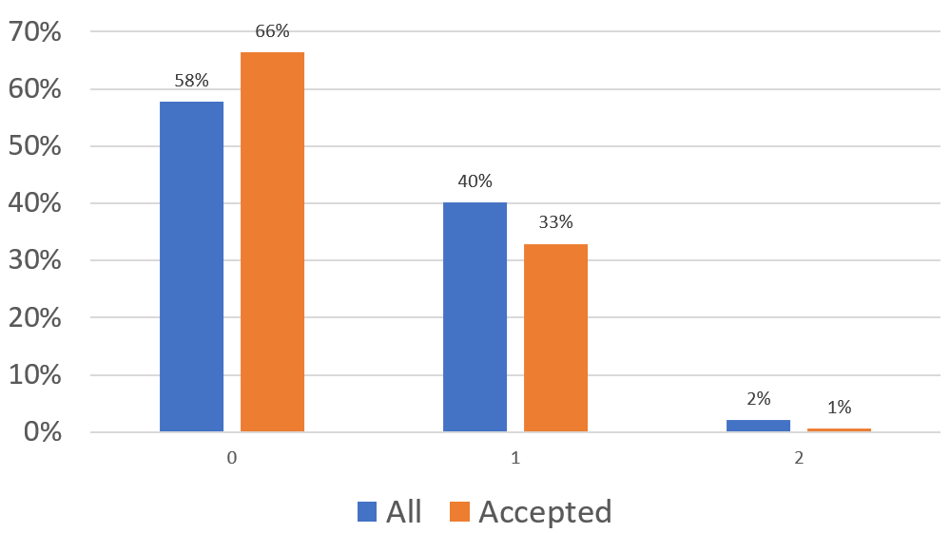
Income and Kids at Home
15% increase
Average Income
Number of Kids at Home

Slide 12

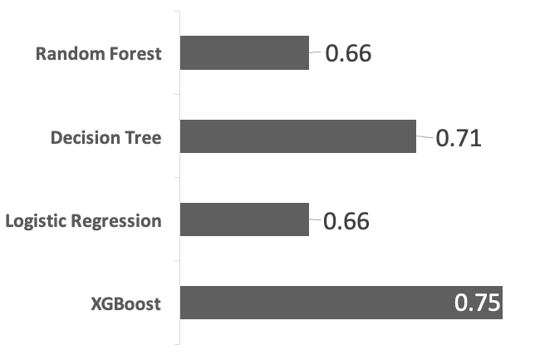



Campaign Response Prediction Supervised Learning
Model AUC – Testing Data
80/20
Train/test split
15/85
Class imbalance restoration
5
Fold cross-validation + parameter tuning
Notes:
Classification accuracy: percentage of correct predictions
Oversampling for logistic regression
Result are for test dataset only
['AcceptedCmp1', 'Income', 'Kidhome', 'AcceptedCmp3', 'AcceptedCmp4', 'AcceptedCmpOverall','Recency','NumDealsPurchases', 'NumWebPurchases','NumStorePurchases']

Slide 13
Confusion matrix
 |  | Predicted Response
 |  | Accept | Not Accept
Actual Response | Accept | 25 | 44
 | Not Accept | 15 | 359
High specificity
96% of ignores were predicted correctly
Low sensitivity
36% of acceptances were predicted correctly
Improved returns
$1.25 ROI vs $(0.5) without model

Slide 14




Customer Segmentation – Clustering Unsupervised Learning Using K-Means
CLUSTER ONE
CLUSTER TWO
CLUSTER THREE
CLUSTER FOUR
CLUSTER FIVE
Low-to-moderate affluence
Avg income of $30,000
Youthful
Avg age of 45, minimum of 26
Not interested in catalogs
Most frequent online browser
High web visits per web purchases ratio
Moderate-to-high affluence
Avg income of $80,000
Middle-Aged
Over 50
Low online presence, but won't shy away from online shopping
Prefers in-store shopping and loves a good catalog purchase
Moderate-to-high affluence
Avg income of $74,000
Middle-Aged
Over 50, minimum of 33
Lowest online presence
Only 3 web visits/month
Focuses on catalog and in-store shopping
Moderate affluence
Avg income of $57,000
Middle-Aged
Over 55 on average
Deal seeker
Online friendly
1st in web purchases, 2nd in website visits
Low-to-moderate affluence
Avg income of $44,000
Old-Aged
Over 60 on average
Infrequent purchaser, but will capitalize on deals
Online friendly, with few online purchases

Slide 15




Cluster Results
 | Response Rate
Cluster 1 | 15%
Cluster 2 | 9%
Cluster 3 | 14%
Cluster 4 | 11%
Cluster 5 | 38%
Testing AUC
0.66
0.75
0.72
0.69
0.78
Cluster 2 and 3 both provide similar accuracy and responsiveness.
Marketing to these groups as one may be more effective.
Cluster 5 is the most responsive and the most predictable.

Slide 16
Targeted Marketing Campaign Refresh
Baseline Campaign Performance
15% fulfillment rate
 | # of Offers | # of Acceptance
All Customers | 2240 (100%) | 334 (15%)
Top Customers | 541 (24.5%) | 851 (38%)
Increase incremental sales by efficient use of marketing spending on new campaign. Top customers are 30% more likely to respond to promotional offering.
 | # of Offers | # of Accepted | Cost of Campaign | Revenue | Profit | ROI
All Customers | 2240 | 334 | $6,624 | $3,641 | -$2,983 | -$0.55
Top Customers | 2240 | 851 | $6,624 | $9,361 | $2,737 | +$1.41
New strategy and tactics will increase global profitability by identifying and targeting valuable customers.
Notes:
Baseline fulfilment rate was only 15% based on historical campaign performance, where 2,208 customers were randomly selected to participate in to purchase the new product. Without any customer segmentation or behavioral analysis, launching a campaign to all customers would result in a total loss of ~$3,000 dollars based on a fixed cost of $6,624 for the entire campaign effort.

Slide 17
Insights for future Campaigns
Using unsupervised learning:
PATTERNS and SPENDING HABITS can be monitored of the top clients
1. Current model provides the best prediction for Cluster 5
Resources should be focused on this segment who look out for deals
2. Marketing insights for Cluster 2 and 3:
3. 95% accuracy for unacceptance of the marketing campaign:
iFood will know to not focus resources for customer segments who will not respond regardless of the marketing campaign
Moderate-to-high affluence
High Income level
Low online presence
Notes:
Utilize machine learning algorithms to enhance cost-effectiveness of marketing campaigns, taper top-level funnel shape, and improve conversion rates.
Leverage unsupervised learning to gain a deeper understanding customer segments and improve customer-to-campaign alignment in future marketing campaigns.
[NOT SURE ABOUT THIS, BUT YOU GET THE IDEA] Consider the customer features that are most important for successfully predicting campaign responses, and implement a strategic plan throughout the business to collect this data and use it to advance business operations.

Slide 18




Conclusion – Reinvent Campaign Cycle
We have what it
takes to make
things different
and better
Access
Identify high value customers
Campaign Cycle
Distribute
Strategize
Proliferate conversion rates
Improve customer-to-campaign alignment
Plan
Enhance cost-effectiveness
Notes:
a. enrich a deeper understanding customer segments
b. improve customer-to-campaign alignment
c. enhance cost-effectiveness of marketing campaigns
d. improve conversion rates

Slide 19
Thank you
THANK YOU

Slide 20
Appendix
Data Source
https://www.kaggle.com/datasets/jackdaoud/marketing-data

Slide 21
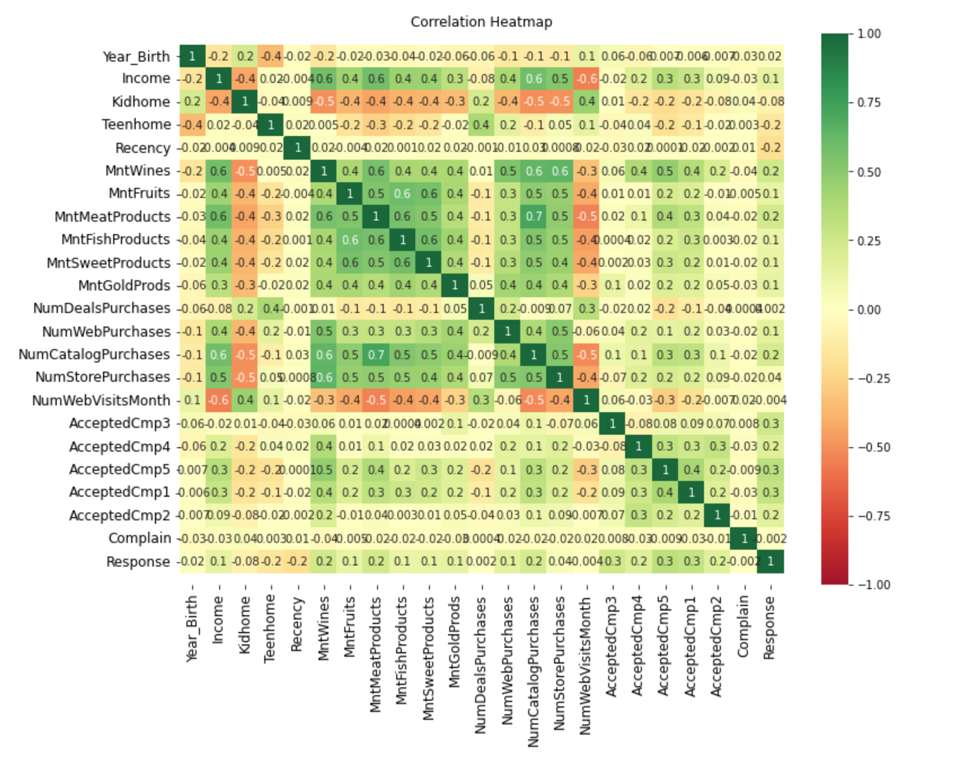
Feature Correlation Heat map
Appendix

Slide 22
Appendix

Slide 23
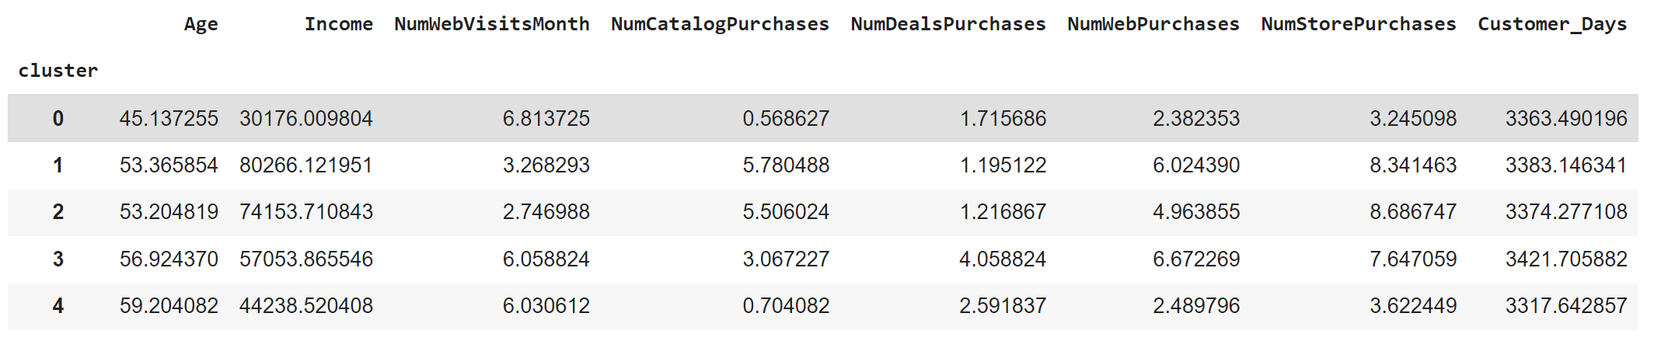
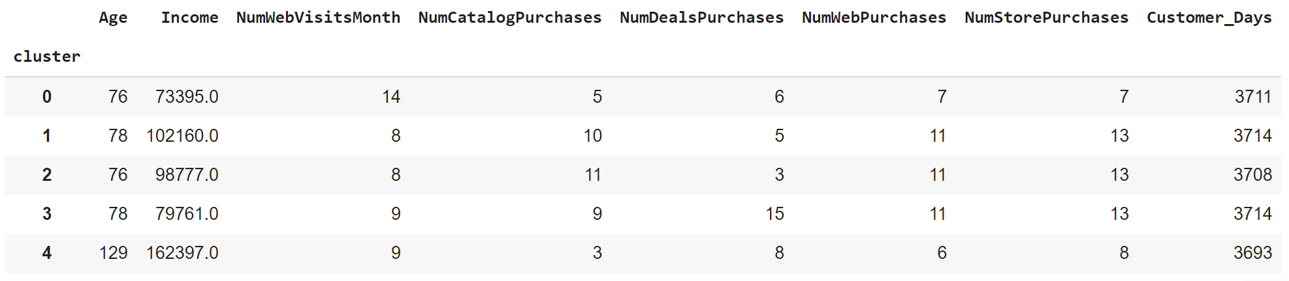
Cluster reference - mean, max, min
Appendix

Slide 24
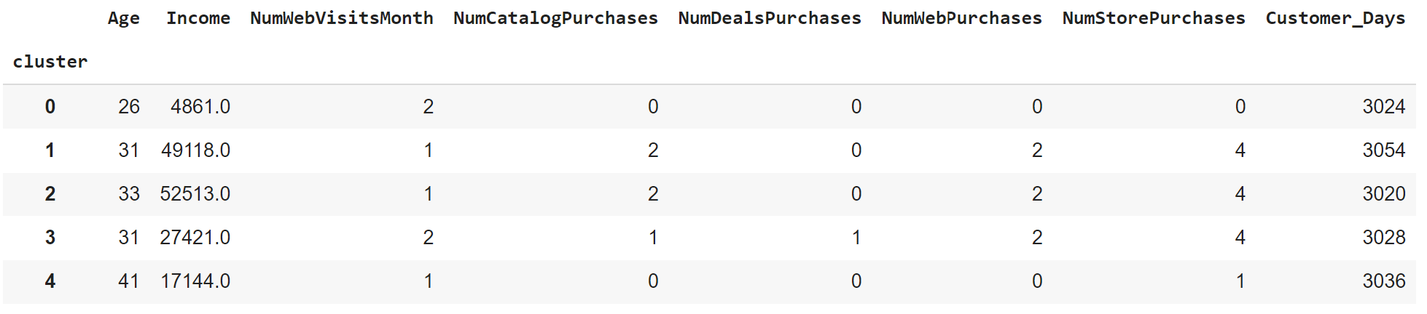
Appendix

Slide 25
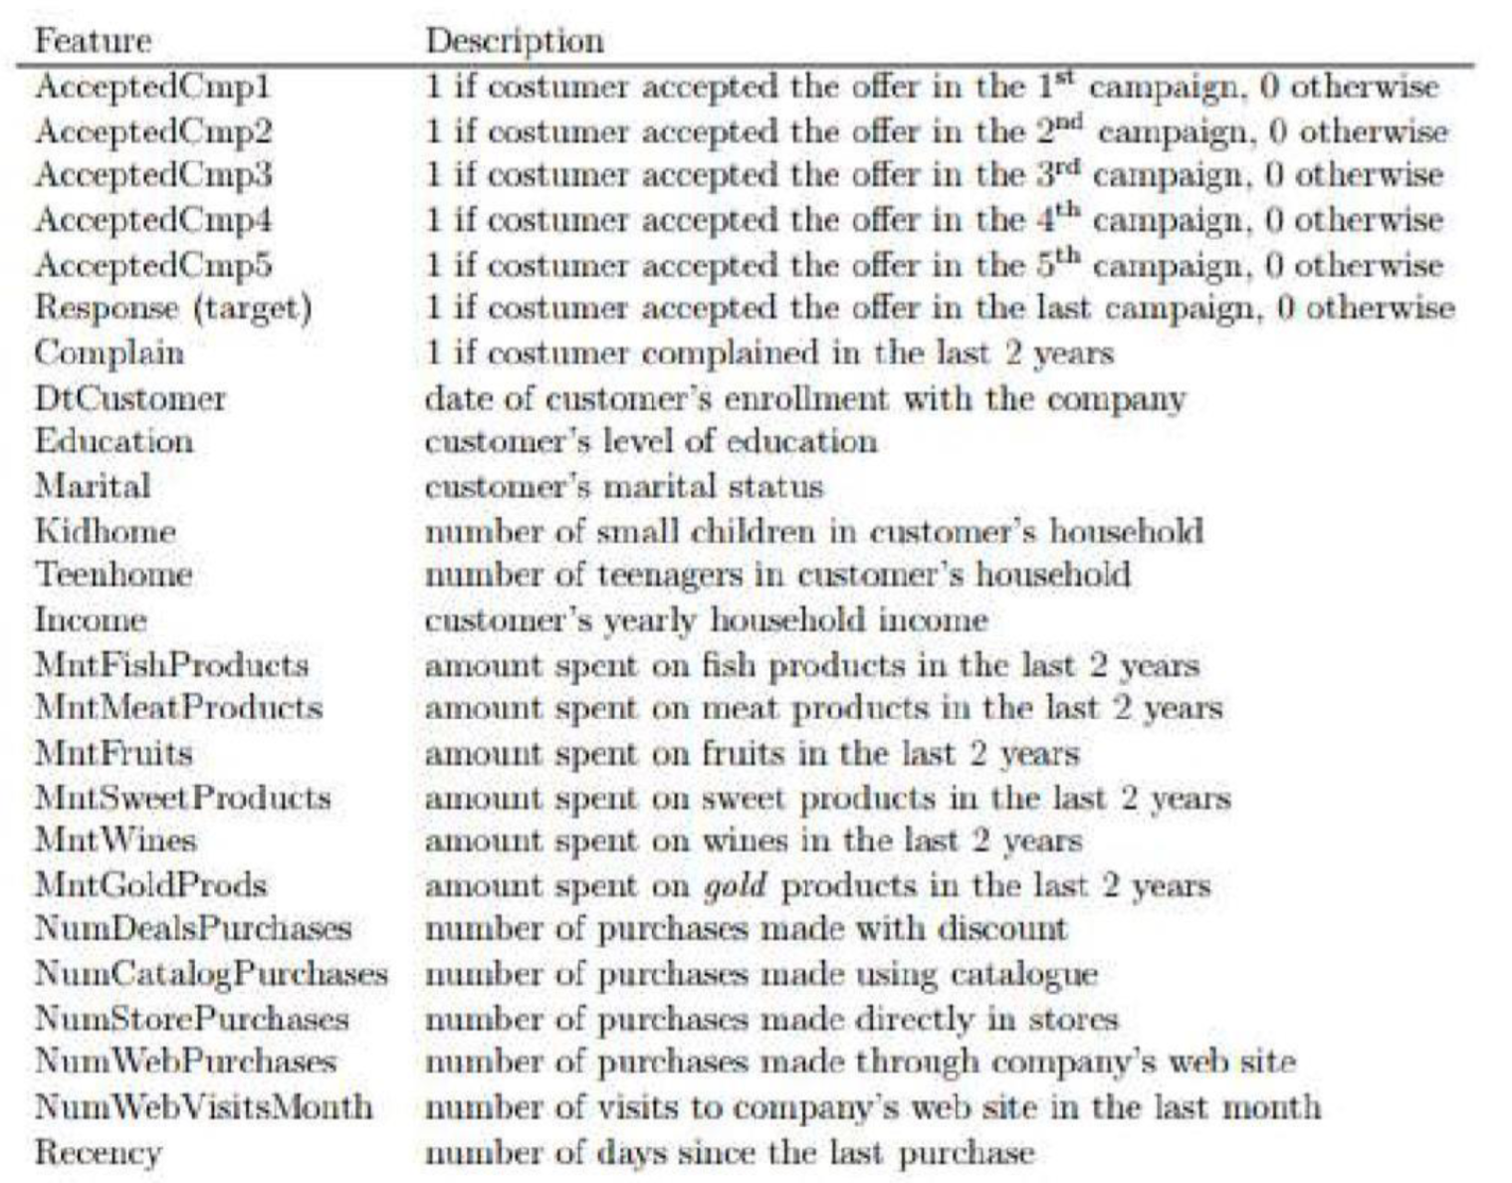
Appendix

Slide 26
Feature Engineering
Calculate age based on birthdate
Number of customers as a customer
Marital_Status, Education categorical column converted
Sum their total monthly spending
RegularProds Spending amount included
Indicator - if customers have accepted any previous campaign
Total dependents at home
Find out total number of purchases

